Slide 1
Figures for
Ecosystem Services
- How Some Wild Animals Protect Human Health
(https://serendipstudio.org/exchange/bioactivities/ecologicaldisturbance)

Slide 2
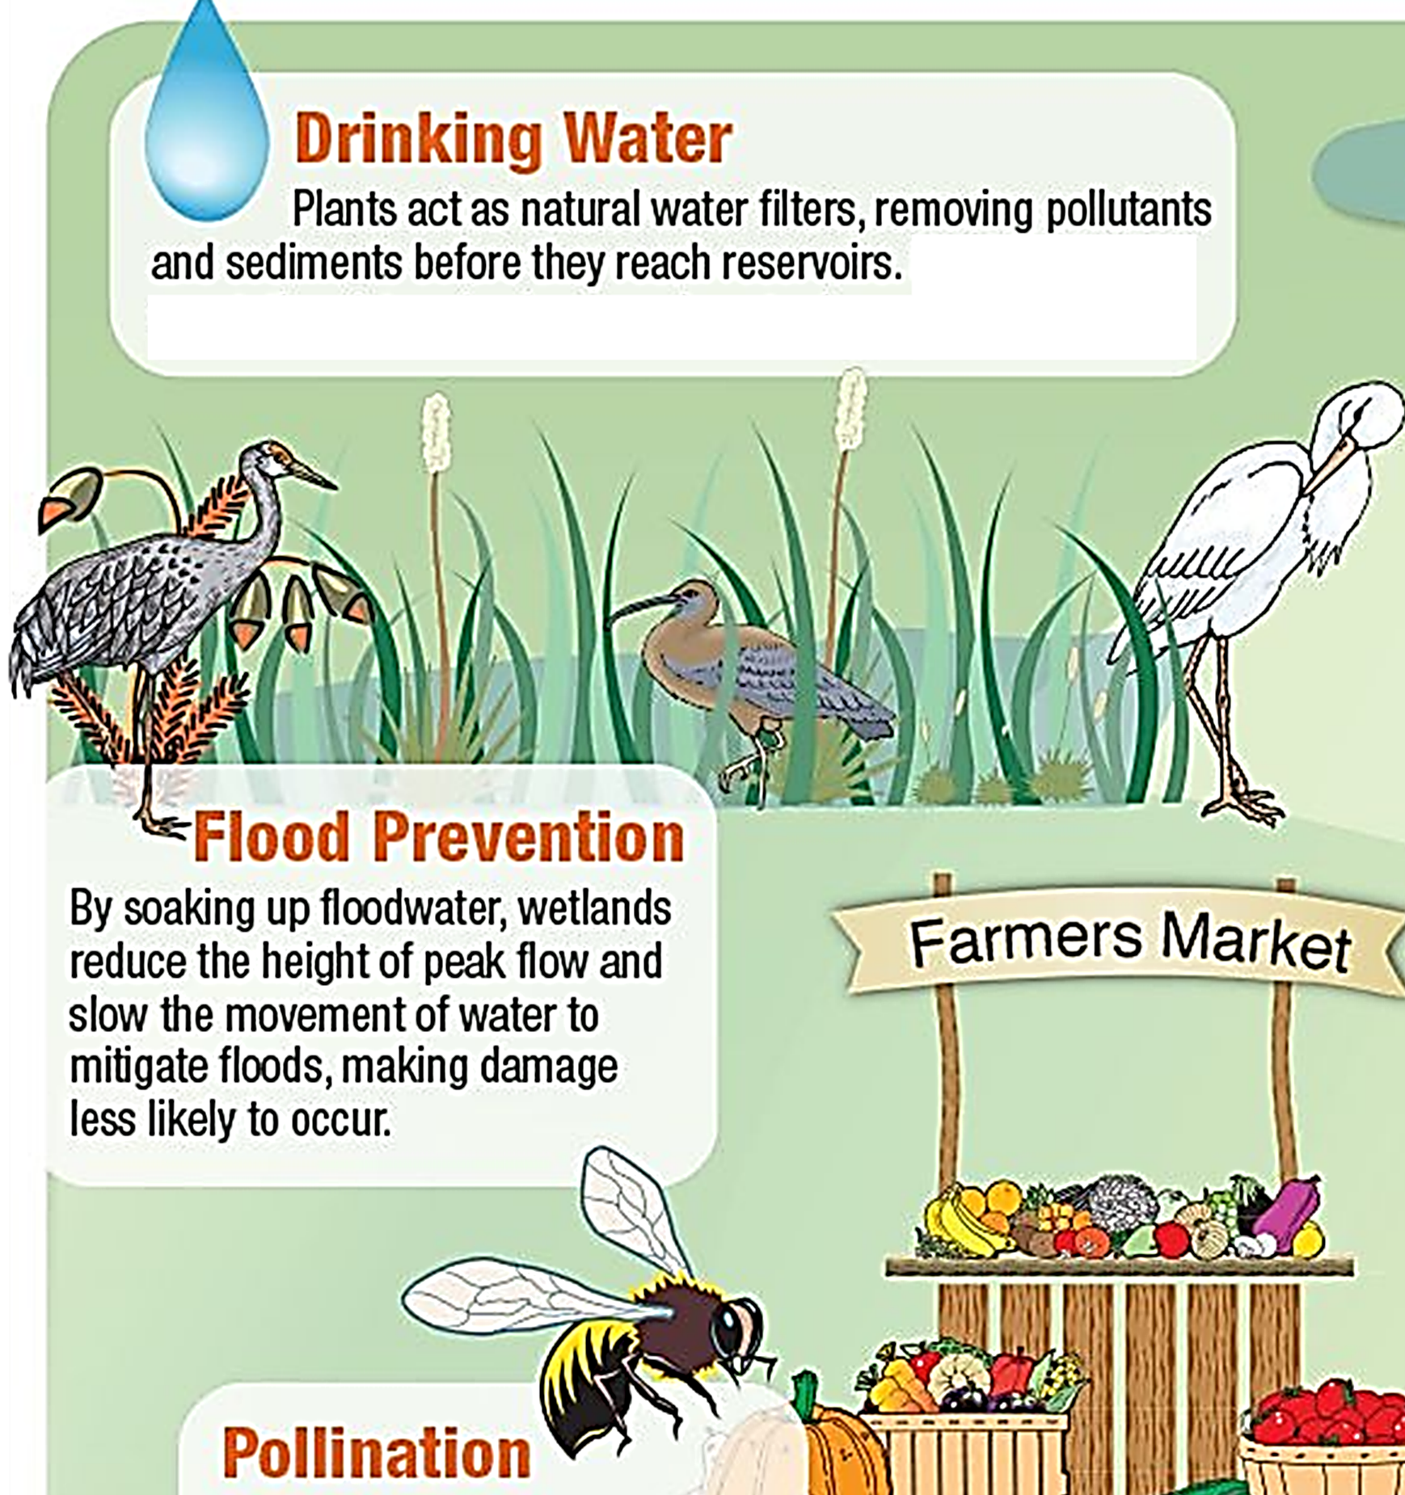

Slide 3
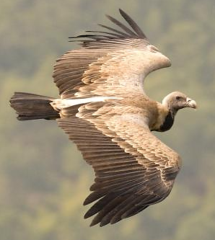

Slide 4
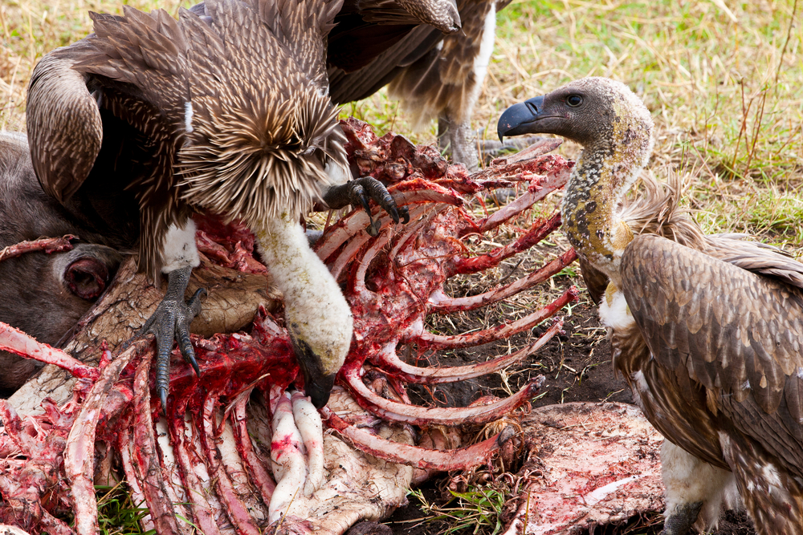

Slide 5
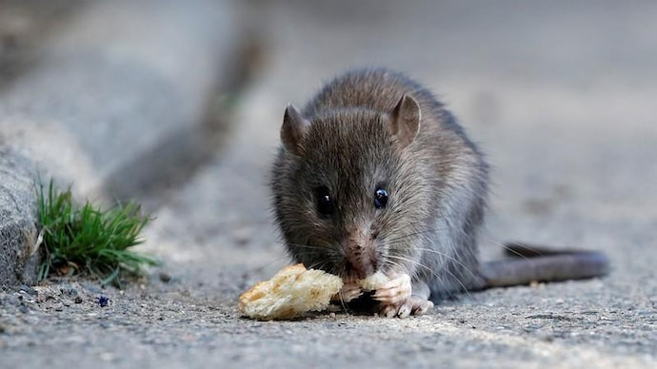

Slide 6
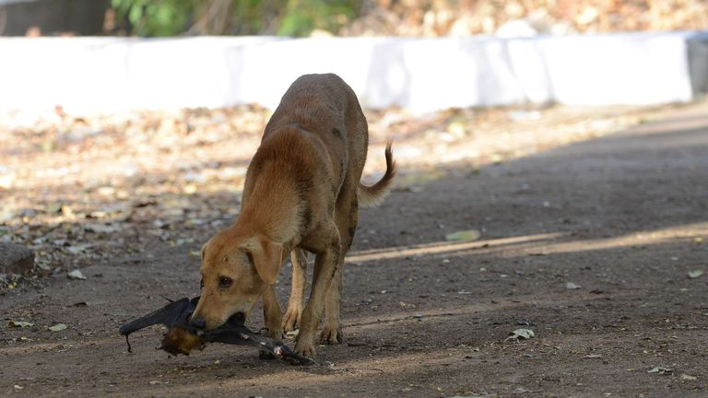

Slide 7
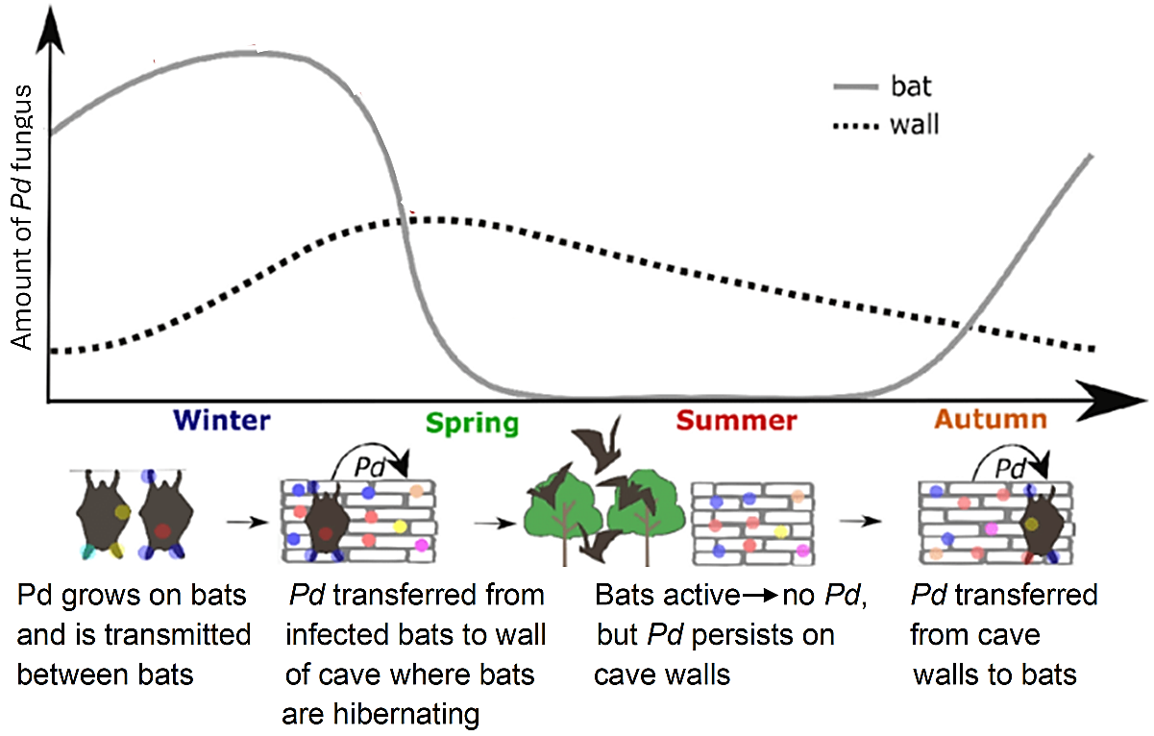

Slide 8
